Slide 1








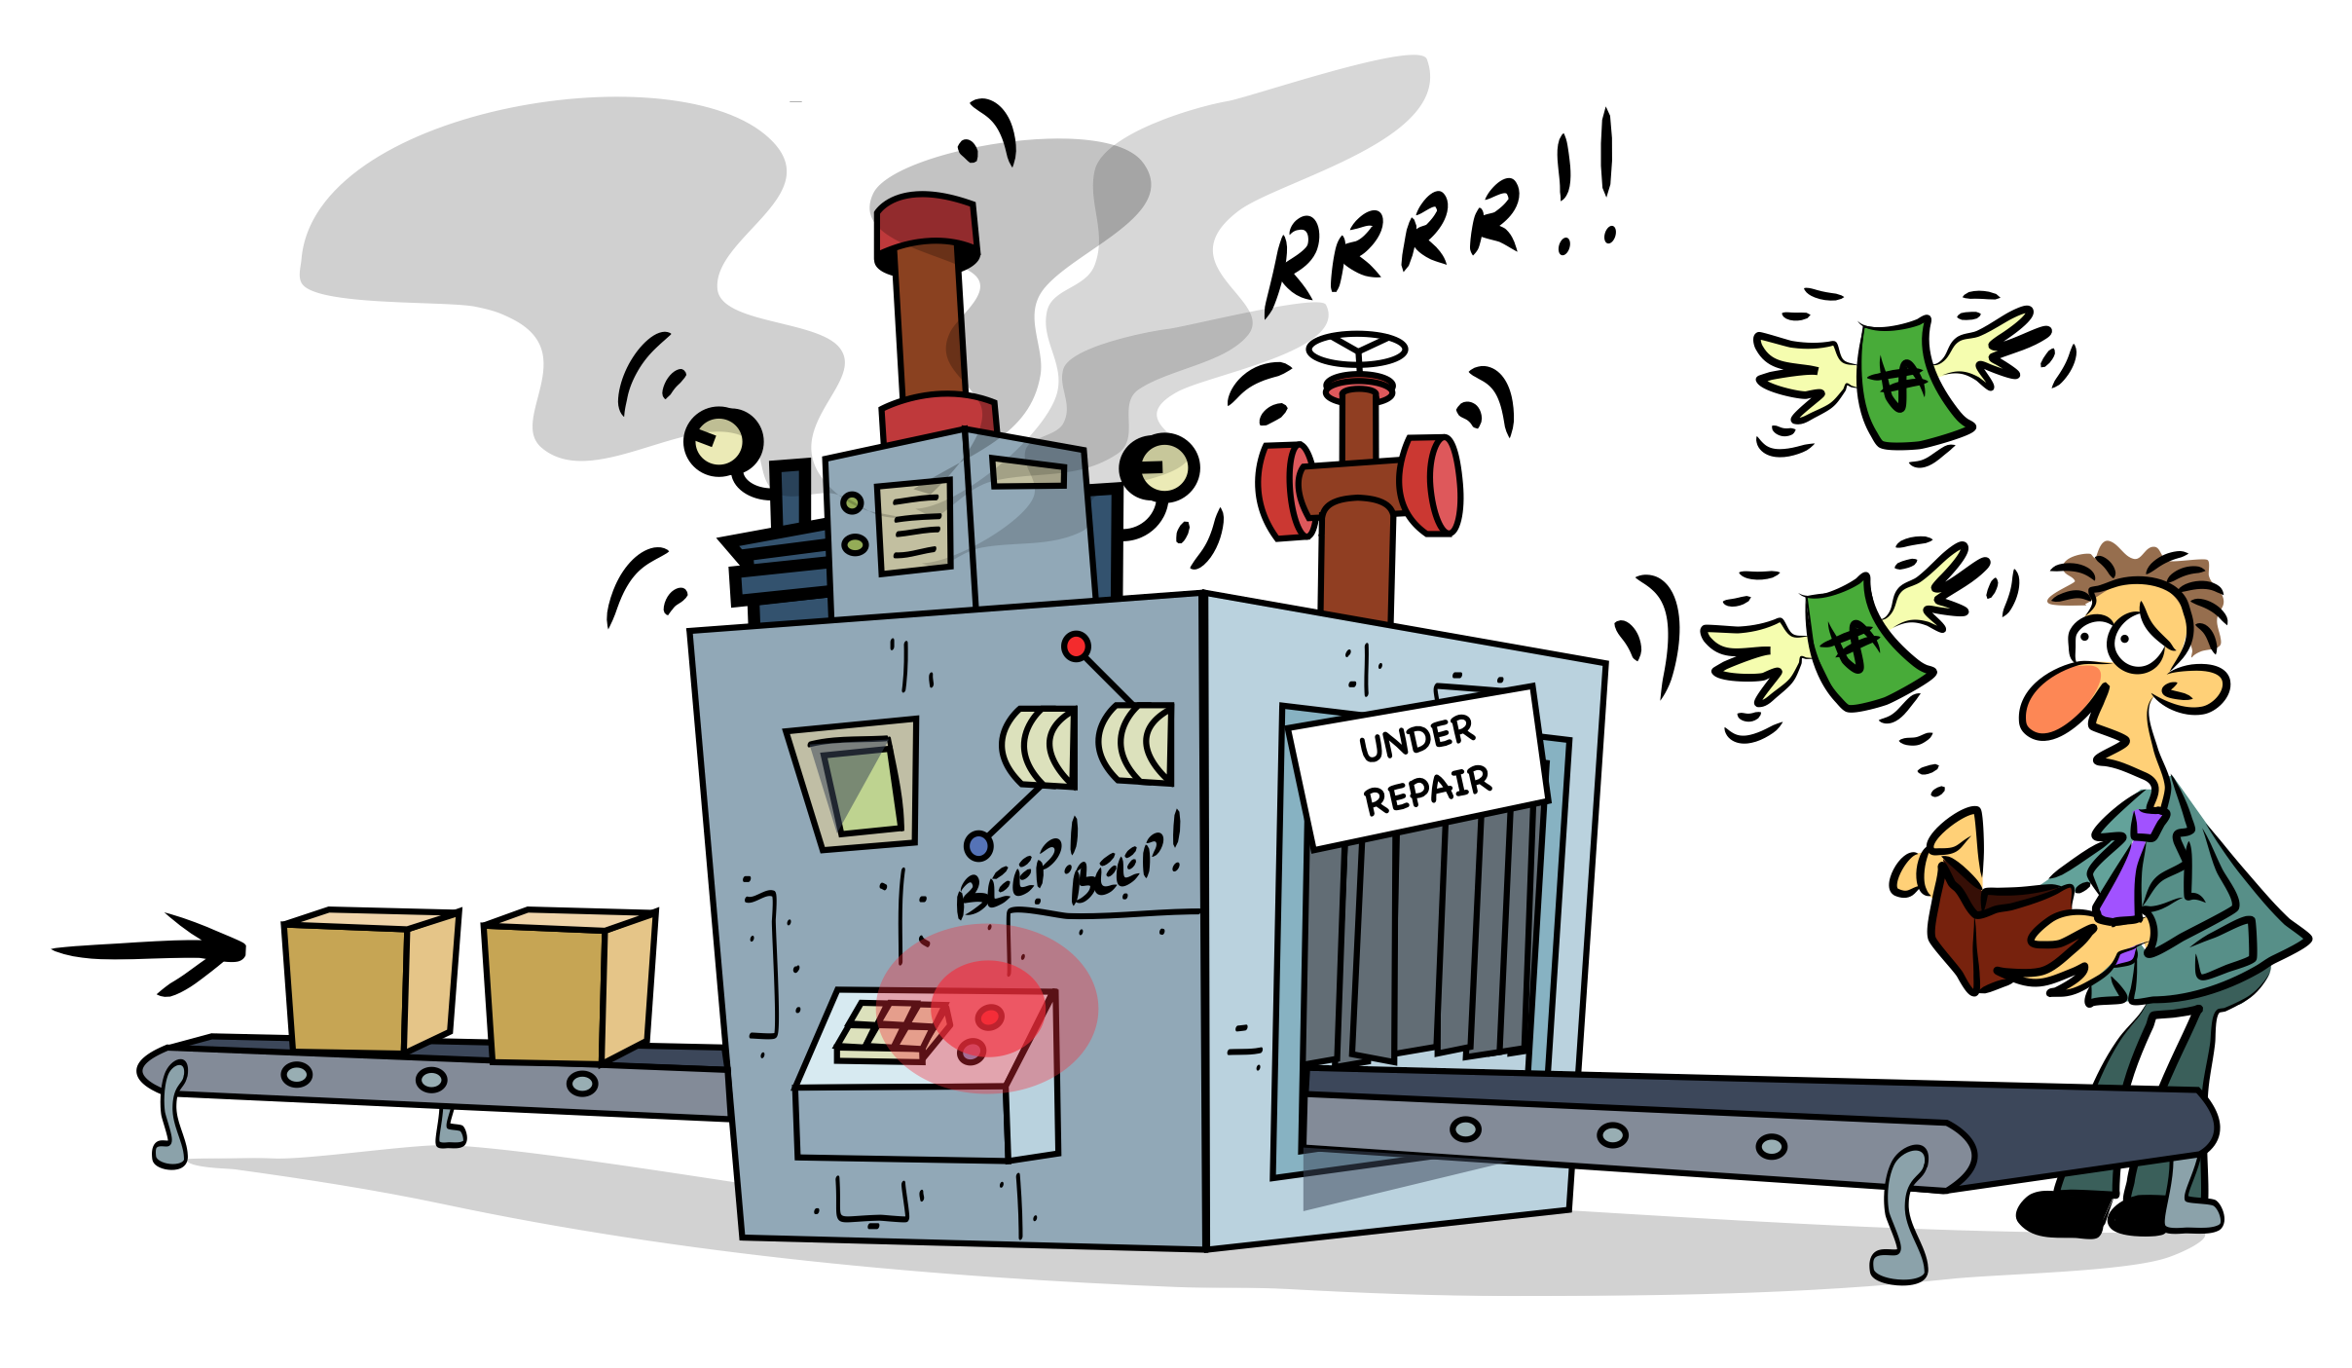
System Architecture Overview
Problem Statement
MEMS based Machine Vibration Monitoring and Management System
It is found from a study that machines often experience problems when they face prolonged vibrations. These vibrations make parts wear out faster, cause breakdowns, create noise, and reduce the quality of work.
This leads to unexpected stoppages, higher repair costs, and lower efficiency, showing the need for a reliable system to track machine vibrations.
Smart Monitoring for Safer Machines
ESP32 Controller
Main processor with WiFi, Bluetooth, and I/O support.
TEAM – 6
23BME007 - AKSHAI U
23BME016 - DEENADHAYALAN B
23BME017 - DEEPAK PRASANNA S M
23BME046 - KEERTHIN P
23BME053 - MITHRANN S S
23BME055 - NAREN K
ADXL345 Accelerometer
3-axis MEMS sensor capturing real-time vibration and acceleration data.
LCD Display
Local status and live vibration readings with calibration prompts.
GSM Module
SIM800 sends SMS alerts for excessive vibration events instantly.

Slide 2
Our Solution
Hardware Architecture
Problem Statement
It is found from a study that machines often experience problems when they face prolonged vibrations. These vibrations make parts wear out faster, cause breakdowns, create noise, and reduce the quality of work.
This leads to unexpected stoppages, higher repair costs, and lower efficiency, showing the need for a reliable system to track machine vibrations.
MEMS based Machine Vibration Monitoring and Management System that can measure vibration and wirelessly log data along with alerts for high vibration
Continuous and Real Time Sensing
ADXL345 measures even the minute fluctuations in vibrations and the ESP32 module process these values to get its equivalent vibration measurement in real time.
Wireless Data Logging and Alert System
The module can wirelessly store the vibration data in the BLYNK WEB CONSOLE and also generate a sound based alert when the vibration exceeds the threshold
Auto Calibration
The module calibrates the threshold value of vibration beyond which an alarm should be triggered automatically
ADXL345 Accelerometer
3-axis MEMS sensor capturing real-time vibration and acceleration data.
ESP32 Controller
Main processor with WiFi, Bluetooth, and I/O support.
GSM Module
SIM800 sends SMS alerts for excessive vibration events instantly.
LCD Display
Local status and live vibration readings with calibration prompts.
MEMS based Machine Vibration Monitoring and Management System
Smart Monitoring for Safer Machines
TEAM – 6
23BME007 - AKSHAI U
23BME016 - DEENADHAYALAN B
23BME017 - DEEPAK PRASANNA S M
23BME046 - KEERTHIN P
23BME053 - MITHRANN S S
23BME055 - NAREN K

Slide 3
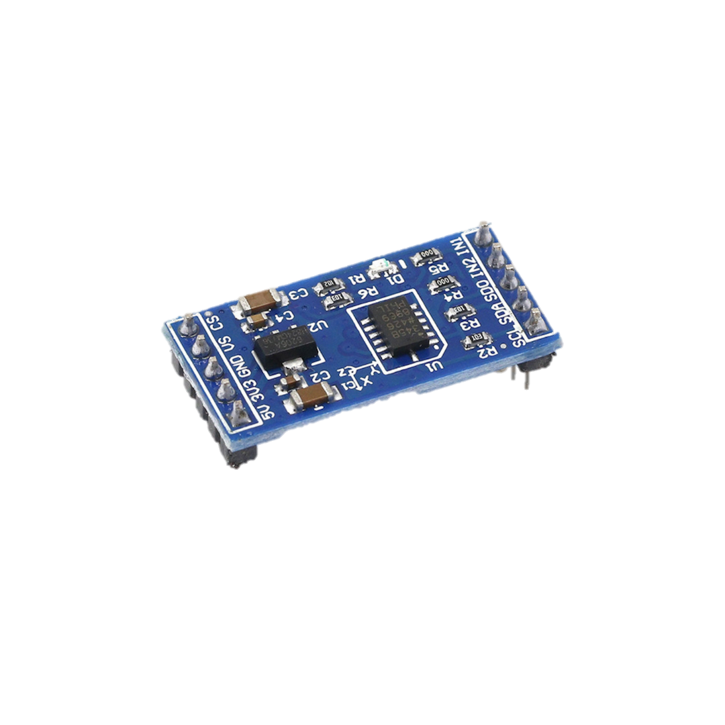
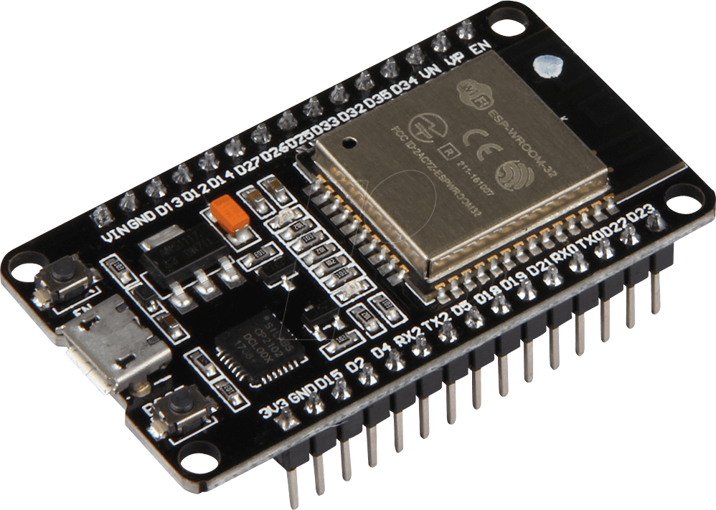
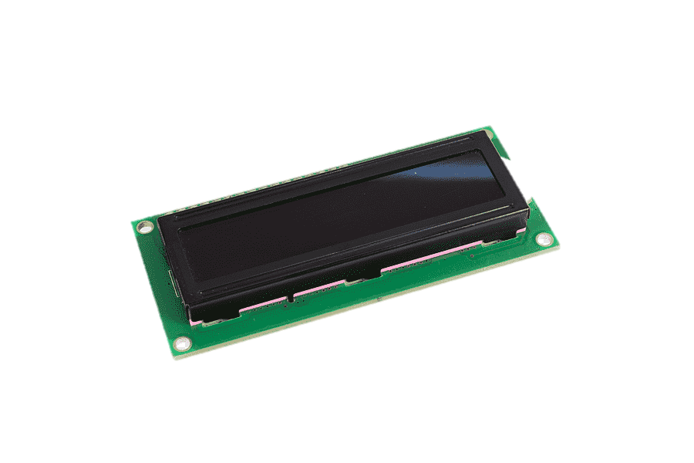
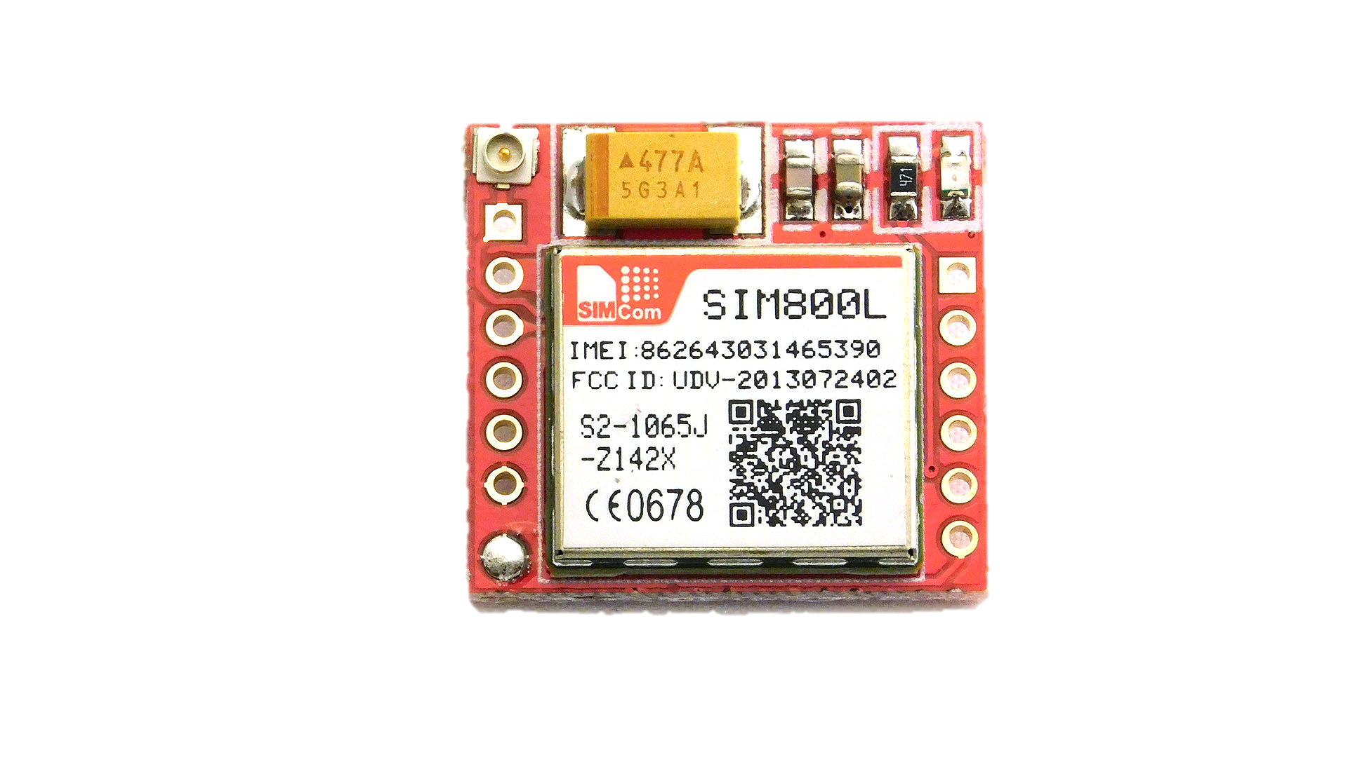
Problem Statement
Hardware Architecture
Our Solution
It is found from a study that machines often experience problems when they face prolonged vibrations. These vibrations make parts wear out faster, cause breakdowns, create noise, and reduce the quality of work.
This leads to unexpected stoppages, higher repair costs, and lower efficiency, showing the need for a reliable system to track machine vibrations.
MEMS based Machine Vibration Monitoring and Management System that can measure vibration and wirelessly log data along with alerts for high vibration
Continuous and Real Time Sensing
ADXL345 measures even the minute fluctuations in vibrations and the ESP32 module process these values to get its equivalent vibration measurement in real time.
Wireless Data Logging and Alert System
The module can wirelessly store the vibration data in the BLYNK WEB CONSOLE and also generate a sound based alert when the vibration exceeds the threshold
Auto Calibration
The module calibrates the threshold value of vibration beyond which an alarm should be triggered automatically
ADXL345 Accelerometer
3-axis MEMS sensor capturing real-time vibration and acceleration data.
ESP32 Controller
Main processor with WiFi, Bluetooth, and I/O support.
GSM Module
SIM800 sends SMS alerts for excessive vibration events instantly.
LCD Display
Local status and live vibration readings with calibration prompts.
MEMS based Machine Vibration Monitoring and Management System
Smart Monitoring for Safer Machines
TEAM – 6
23BME007 - AKSHAI U
23BME016 - DEENADHAYALAN B
23BME017 - DEEPAK PRASANNA S M
23BME046 - KEERTHIN P
23BME053 - MITHRANN S S
23BME055 - NAREN K

Slide 4
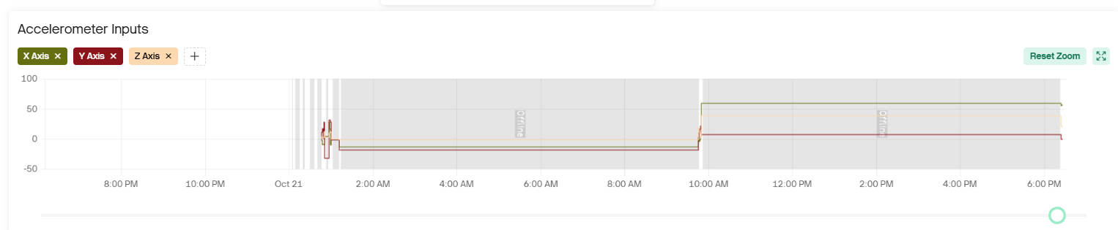
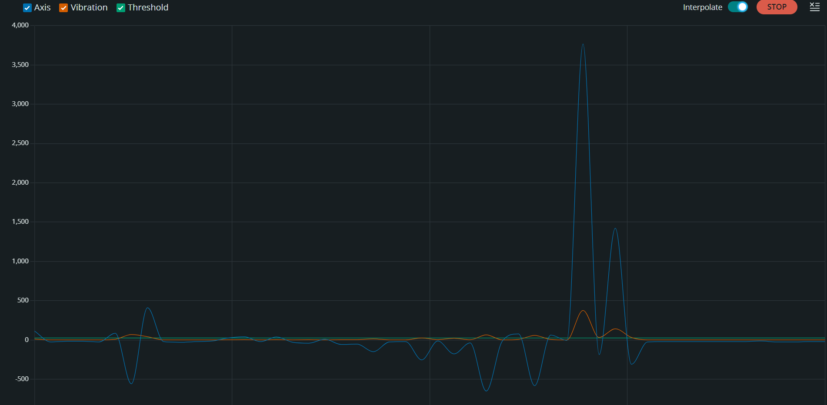
Our Solution
MEMS based Machine Vibration Monitoring and Management System that can measure vibration and wirelessly log data along with alerts for high vibration
Continuous and Real Time Sensing
ADXL345 measures even the minute fluctuations in vibrations and the ESP32 module process these values to get its equivalent vibration measurement in real time.
Wireless Data Logging and Alert System
The module can wirelessly store the vibration data in the BLYNK WEB CONSOLE and also generate a sound based alert when the vibration exceeds the threshold
Auto Calibration
The module calibrates the threshold value of vibration beyond which an alarm should be triggered automatically
SOFTWARE IMPLEMENTATION
REAL TIME REPRESENTATION OF AXIS, VALUES in Blynk Console along with Alarm on excessive vibrations being detected
Hardware Architecture
ESP32 Controller
ADXL345 Accelerometer
Main processor with WiFi, Bluetooth, and I/O support.
3-axis MEMS sensor capturing real-time vibration and acceleration data.
LCD Display
GSM Module
Local status and live vibration readings with calibration prompts.
SIM800 sends SMS alerts for excessive vibration events instantly.
Real time representation of axis, vibration and the threshold values in Arduino IDE serial monitor
MEMS based Machine Vibration Monitoring and Management System
Smart Monitoring for Safer Machines
TEAM – 6
23BME007 - AKSHAI U
23BME016 - DEENADHAYALAN B
23BME017 - DEEPAK PRASANNA S M
23BME046 - KEERTHIN P
23BME053 - MITHRANN S S
23BME055 - NAREN K

Slide 5
System Architecture Overview
LIVE DEMO : Workflow & Operation
SOFTWARE IMPLEMENTATION
Device Startup
LCD shows status and connection messages.
WiFi connects to Blynk; GSM module initializes.
Calibration
User presses boot button to calibrate at any time.
Baseline offsets and thresholds computed.
Monitoring
Calibrated sensor data is streamed and visualized (V0=X, V1=Y, V2=Z, V3=Vibration).
LCD displays real-time vibration frequency.
Alert and Logging
Dashboard alerts trigger on excessive vibration.
Status and history maintained for remote monitoring.
Manual Recalibration
Boot button allows recalibration during normal operation.
REAL TIME REPRESENTATION OF AXIS, VALUES in Blynk Console along with Alarm on excessive vibrations being detected
ESP32 Controller
Main processor with WiFi, Bluetooth, and I/O support.
ADXL345 Accelerometer
Real time representation of axis, vibration and the threshold values in Arduino IDE serial monitor
3-axis MEMS sensor capturing real-time vibration and acceleration data.
LCD Display
Local status and live vibration readings with calibration prompts.
GSM Module
SIM800 sends SMS alerts for excessive vibration events instantly.

Slide 6
System Architecture Overview
SOFTWARE IMPLEMENTATION
REAL TIME REPRESENTATION OF AXIS, VALUES in Blynk Console along with Alarm on excessive vibrations being detected
LIVE DEMO : Workflow & Operation
Real time representation of axis, vibration and the threshold values in Arduino IDE serial monitor
Device Startup
LCD shows status and connection messages.
WiFi connects to Blynk; GSM module initializes.
Calibration
User presses boot button to calibrate at any time.
Baseline offsets and thresholds computed.
Monitoring
Calibrated sensor data is streamed and visualized (V0=X, V1=Y, V2=Z, V3=Vibration).
LCD displays real-time vibration frequency.
Alert and Logging
Dashboard alerts trigger on excessive vibration.
Status and history maintained for remote monitoring.
Manual Recalibration
Boot button allows recalibration during normal operation.
ESP32 Controller
Affordable Solution
Main processor with WiFi, Bluetooth, and I/O support.
Predictive Maintenance
Open-source hardware and cloud platforms reduce monitoring costs significantly.
ADXL345 Accelerometer
3-axis MEMS sensor capturing real-time vibration and acceleration data.
Early vibration detection prevents equipment failure and reduces downtime.
LCD Display
Local status and live vibration readings with calibration prompts.
GSM Module
SIM800 sends SMS alerts for excessive vibration events instantly.
Real-Time Insights
Continuous monitoring provides actionable data for maintenance decisions.

Slide 7
System Architecture Overview
LIVE DEMO : Workflow & Operation
SOFTWARE IMPLEMENTATION
REAL TIME REPRESENTATION OF AXIS, VALUES in Blynk Console along with Alarm on excessive vibrations being detected
RESULTS AND POSITIVE IMPACTS
Real time representation of axis, vibration and the threshold values in Arduino IDE serial monitor
Device Startup
LCD shows status and connection messages.
WiFi connects to Blynk; GSM module initializes.
Calibration
User presses boot button to calibrate at any time.
Baseline offsets and thresholds computed.
Monitoring
Calibrated sensor data is streamed and visualized (V0=X, V1=Y, V2=Z, V3=Vibration).
LCD displays real-time vibration frequency.
Alert and Logging
Dashboard alerts trigger on excessive vibration.
Status and history maintained for remote monitoring.
Manual Recalibration
Boot button allows recalibration during normal operation.
Affordable Solution
Predictive Maintenance
Open-source hardware and cloud platforms reduce monitoring costs significantly.
Early vibration detection prevents equipment failure and reduces downtime.
ESP32 Controller
Main processor with WiFi, Bluetooth, and I/O support.
ADXL345 Accelerometer
3-axis MEMS sensor capturing real-time vibration and acceleration data.
Real-Time Insights
LCD Display
Continuous monitoring provides actionable data for maintenance decisions.
Local status and live vibration readings with calibration prompts.
GSM Module
SIM800 sends SMS alerts for excessive vibration events instantly.

Slide 8




System Architecture Overview
RESULTS AND POSITIVE IMPACTS
LIVE DEMO : Workflow & Operation
SOFTWARE IMPLEMENTATION
Future Enhancements
REAL TIME REPRESENTATION OF AXIS, VALUES in Blynk Console along with Alarm on excessive vibrations being detected
AI Analytics
Real time representation of axis, vibration and the threshold values in Arduino IDE serial monitor
Device Startup
LCD shows status and connection messages.
WiFi connects to Blynk; GSM module initializes.
Calibration
User presses boot button to calibrate at any time.
Baseline offsets and thresholds computed.
Monitoring
Calibrated sensor data is streamed and visualized (V0=X, V1=Y, V2=Z, V3=Vibration).
LCD displays real-time vibration frequency.
Alert and Logging
Dashboard alerts trigger on excessive vibration.
Status and history maintained for remote monitoring.
Manual Recalibration
Boot button allows recalibration during normal operation.
Machine learning models predict equipment failures before they occur.
Data Logging
Store historical vibration data for long-term trend analysis and pattern recognition.
Predictive Maintenance
ESP32 Controller
Main processor with WiFi, Bluetooth, and I/O support.
Enhanced Visualization
ADXL345 Accelerometer
Early vibration detection prevents equipment failure and reduces downtime.
3-axis MEMS sensor capturing real-time vibration and acceleration data.
Advanced dashboard with 3D vibration mapping and comparative analytics across machinery fleet.
Affordable Solution
LCD Display
Open-source hardware and cloud platforms reduce monitoring costs significantly.
Multi-Sensor Expansion
Local status and live vibration readings with calibration prompts.
GSM Module
Add temperature, humidity, and acoustic sensors for comprehensive machine health monitoring.
SIM800 sends SMS alerts for excessive vibration events instantly.
Real-Time Insights
Continuous monitoring provides actionable data for maintenance decisions.

